Slide 1
Machine Guarding and Safety Around Machinery
Susan Harwood Training Grant
SH-31190-SH7
Notes:
This course was developed from funds received from The Occupational Safety & Health Administration.

Slide 2
Disclaimers
This material was produced under grant number SH-31190-SH7 from the Occupational Safety and Health Administration, U.S. Department of Labor. It does not necessarily reflect the views or policies of the U.S. Department of Labor, nor does mention of trade names, commercial products, or organizations imply endorsement by the U.S. Government.
This training is not intended to replace site or company specific training on the recognition and control of hazards in the workplace.
Photos shown in this presentation may depict situations that are not in compliance with applicable OSHA/safety requirements.
It is the responsibility of the employer and its employees to comply with all pertinent OSHA/safety rules and regulations in the jurisdiction in which they work.

Slide 3
OSHA and your rights
In the event of:
Firing of laying off
Blacklisting
Demoting
Denying overtime or promotion
Disciplining
Denial of benefits
Failure to hire or rehire
Intimidation/harassment
Making threats
Reassignment affecting prospects for promotion
Reducing pay/hours
You have protection
Notes:
This is the point to discuss employee/employer rights and responsibilities and whistleblower protection
Whistleblower protection - https://www.whistleblowers.gov/wb_filing_time_limits.html
Section 11(c) of the Occupational Safety & Health Act (OSHA). [29 U.S.C. §660(c)] Section 11(c) provides protection for employees who exercise a variety of rights guaranteed under the Act, such as filing a safety and health complaint with OSHA, participating in an inspection, etc.
Employees have 30 days to file in the event of these adverse actions of employers.
PROTECTION FROM WORKPLACE RETALIATION
Protection from workplace retaliation means that an employer cannot take an "adverse action" against workers, such as:
Firing or laying off
Blacklisting
Demoting
Denying overtime or promotion
Disciplining
Denial of benefits
Failure to hire or rehire
Intimidation/harassment
Making threats
Reassignment affecting prospects for promotion
Reducing pay or hours

Slide 4
OSHA’s Mission
With the Occupational Safety and Health Act of 1970, Congress created the Occupational Safety and Health Administration (OSHA) to assure safe and healthful working conditions for working men and women by setting and enforcing standards and by providing training, outreach, education and assistance.
Notes:
OSHA’s mission
Assure safe and healthful workplaces, and preserve human resources
Establish training programs
Develop mandatory job safety and health standards and enforce them effectively

Slide 5
Your Rights
The Occupational Safety and Health Act of 1970 gives employees and their representatives the right to file a complaint and request an OSHA inspection of their workplace if they believe there is a serious hazard or their employer is not following OSHA standards.
The complaint should be filed as soon as possible after noticing the hazard or lack of compliance because OSHA citations may only be issued for violations that currently exist or existed in the past 6 months.
Complaints from workers or their representatives are taken seriously by OSHA. OSHA will keep your information confidential.
How to file a complaint:
By phone
By fax
Online
In writing
In person
It is illegal for your employer to fire you for contacting OSHA
Notes:
You have the right to speak up. It is illegal for your employer to fire your contacting OSHA. Have an open dialog with your supervisor and management team to discuss any safety issues.
The Occupational Safety and Health Act of 1970 gives employees and their representatives the right to file a complaint and request an OSHA inspection of their workplace if they believe there is a serious hazard or their employer is not following OSHA standards. Workers do not have to know whether a specific OSHA standard has been violated in order to file a complaint. The complaint should be filed as soon as possible after noticing the hazard or lack of compliance because OSHA citations may only be issued for violations that currently exist or existed in the past 6 months.
Complaints from workers or their representatives are taken seriously by OSHA. OSHA will keep your information confidential.

Slide 6
OSHA code of federal regulations
http://www.osha.gov
Notes:
Where to find the information

Slide 7
Machinery, Moving Parts, People and Safeguards
Machinery and People Safety
People and moving machinery do not mix very well, at some point physical interaction between man and machine will take place!
Maintenance activities
Clearing blockages
Cleaning

Slide 8
Machinery, Moving Parts, People and Safeguards
Machinery and People Safety
Why !
Morally
Safe and free from harm
Legally
Because the dangers from unguarded moving machine parts are real and can cause serious harm or death.

Slide 9
Machinery, Moving Parts, People, and Safeguards
Machinery and People Safety
To prevent accidental or inadvertent contact between people and moving machinery, we must have safeguards in place.
Guarding
Controls
Procedures

Slide 10
Principle Machinery Hazards
Machinery and People Safety
So what are the Hazards ?
Can you give any examples ?
The hazards are…..
Notes:
Discussion with class on these questions…

Slide 11
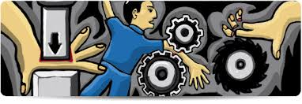
Principle Machinery Hazards
Five Principle Mechanical Hazards associated with moving parts of machines
Contact or Entanglement
Drawing in
Shearing
Crushing and Impact
Cutting, Friction and Abrasions

Slide 12
Machinery Hazards
Moving machinery can cause injuries in many ways:
People can be struck and injured by moving parts of machinery or ejected material.
Parts of the body can also be drawn in or trapped between rollers, belts and pulley drives.
Sharp edges can cause cuts and severing injuries, sharp-pointed parts can cause stabbing or puncture the skin, and rough surface parts can cause friction or abrasion.

Slide 13
Machinery Hazards
People can be crushed, both between parts moving together or towards a fixed part of the machine, wall or other object, and two parts moving past one another can cause shearing.
Parts of the machine, materials and emissions (such as steam or water) can be hot or cold enough to cause burns or scalds and electricity can cause electrical shock and burns.
Injuries can also occur due to machinery becoming unreliable and developing faults or when machines are used improperly through inexperience or lack of training.

Slide 14
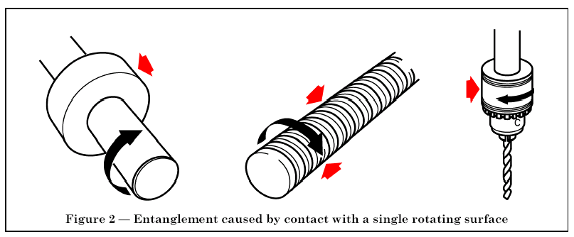
Machinery Hazards
CONTACT or ENTANGLEMENT

Slide 15
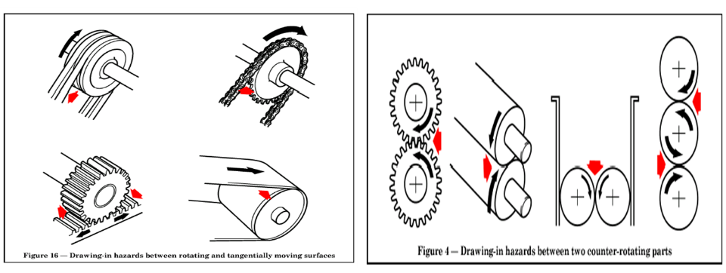
Machinery Hazards
DRAWING IN

Slide 16
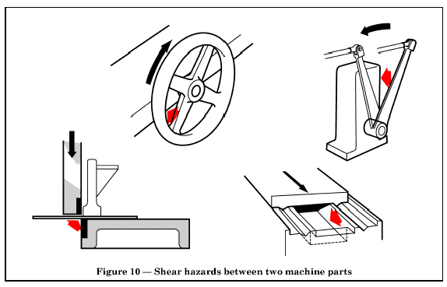
Machinery Hazards
SHEARING

Slide 17
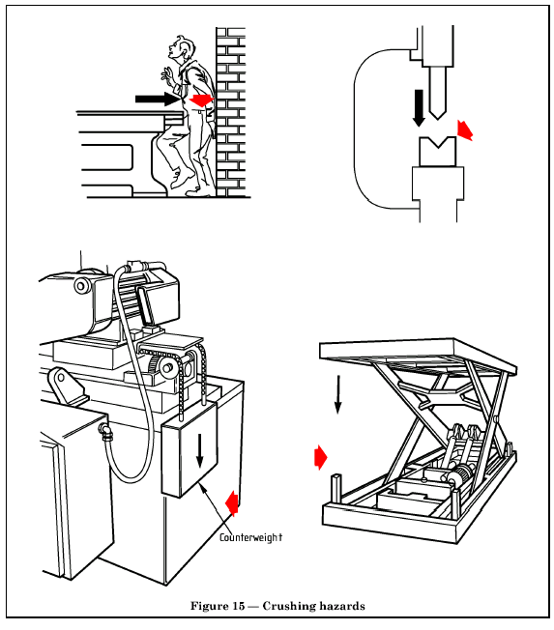
Machinery Hazards
CRUSHING

Slide 18
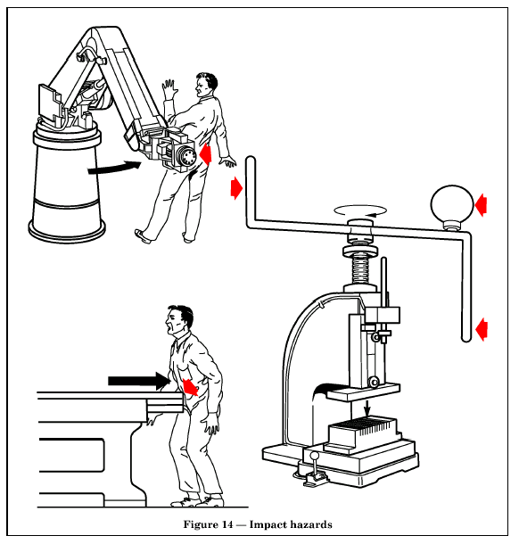
Machinery Hazards
IMPACT

Slide 19
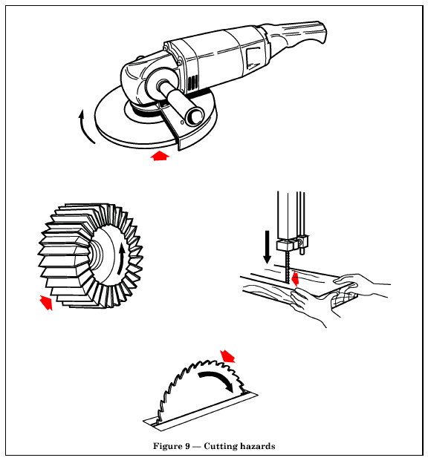
Machinery Hazards
CUTTING

Slide 20
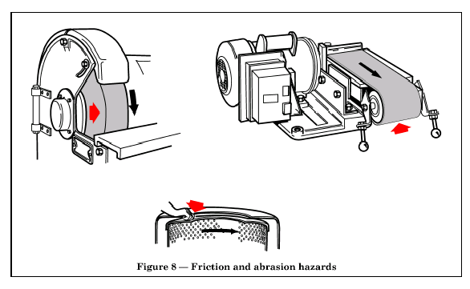
Machinery Hazards
FRICTION and ABRAISIONS

Slide 21
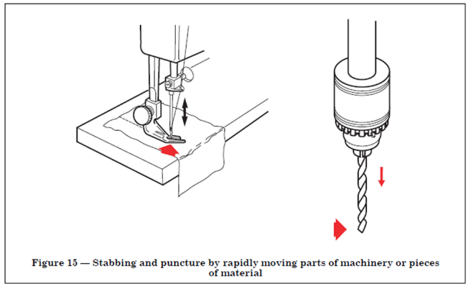
Machinery Hazards
Stabbing and Puncture

Slide 22
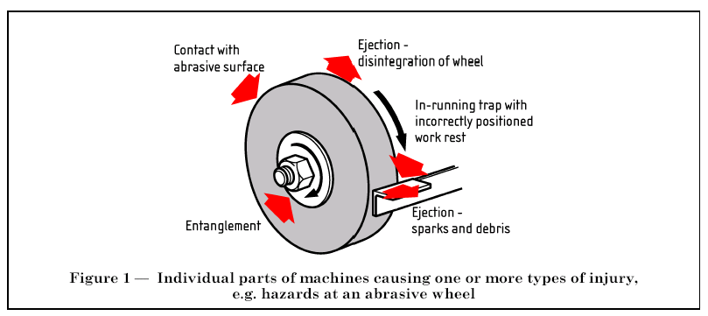
Machinery Hazards
NUMEROUS HAZARDS

Slide 23
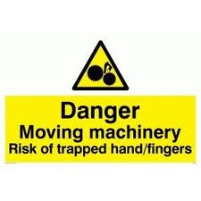
Machinery Safeguards
Safeguarding from Machinery Hazards
There are many means of ensuring people do not come into contact with moving parts of machines.
Most notably, GUARDING

Slide 24
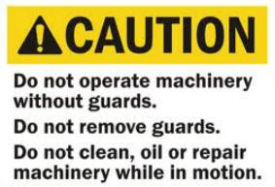
Machinery Safeguards
Reasons guards are removed
Lubrication
Maintenance
Minor adjustments
Take protective measures if guards must be removed to perform maintenance

Slide 25
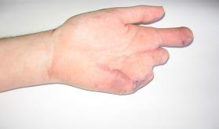
Machinery Safeguards
Safeguarding from Machinery Hazards
Just one of the thousands of horrific yet
preventable workplace injuries reported each year.
Safeguards on machines come in many forms.
Fixed
Interlocked
Distance/Close

Slide 26
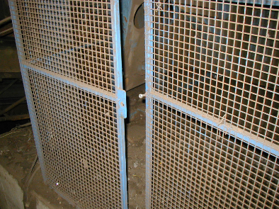
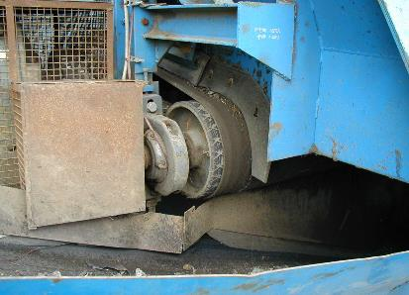
Machinery Safeguards
Safeguarding from Machinery Hazards
Not locked with tool, nut only finger tight
Hand reaches across to drawing in hazards

Slide 27
Machinery Safeguards
Shearing Hazard
Entanglement & Friction Hazards

Slide 28
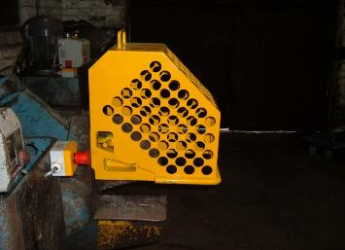
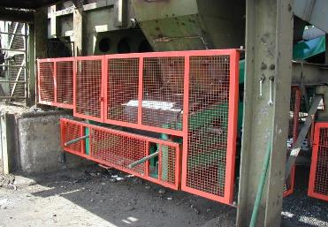
Machinery Safeguards
Safeguarding from Machinery Hazards
Fixed guards should be used wherever possible, properly fastened
(nuts and bolts, padlocked)
Which needs a tool to unfasten/remove (spanner, key).
So that it is not EASILY defeated.
If you need regular access, and a fixed guard is not possible, interlock guard systems can be installed so that machinery is isolated before access.

Slide 29
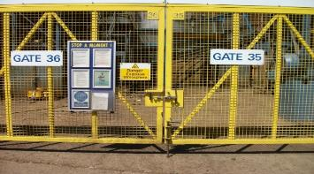
Machinery Safeguards
Safeguarding from Machinery Hazards
Distance guarding, preventing access to dangerous areas.
Interlocked which immediately stops the item of machinery, once the
lock is opened.
Machinery requires resetting once the gates are closed before
restart is possible.

Slide 30
Machinery Safeguards
The machinery must be isolated and ‘locked out and tagged out’ before entry to behind guards is permitted. (moving parts).
Isolation means the machine cannot be accidentally or inadvertently switched back on.
Just switching a machine off is not ENOUGH!
Notes:
Discuss the point of operation and the different types of possible stored energy.
Get attendees talking about their LOTO programs; they should confidently know how their program works
Electrical, gravity, thermal, hydraulic, pneumatic, mechanical, etc.

Slide 31
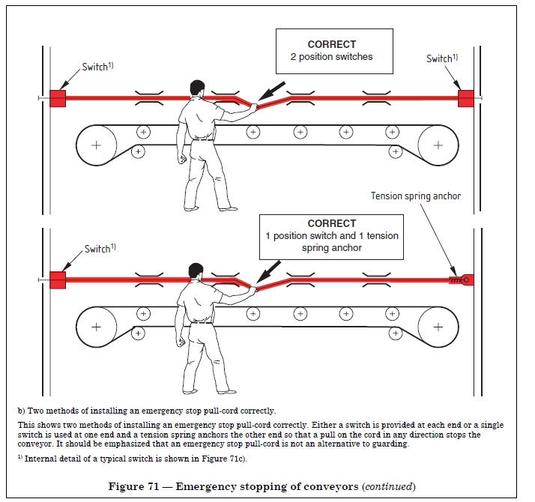
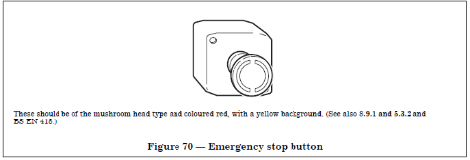
Controls
Operators working around machinery need to familiarise themselves with the location and operation of the equipment’s emergency stop system(s).

Slide 32
First Day on the Job
https://www.youtube.com/watch?v=cNcsTRQNZLE
First Day on the Job was His Last: What Happened to Day Davis
Bacardi Bottling Plant – Jacksonville, FL – August 16, 2012
Notes:
This is the story of a temporary worker who dies on his first day at work by getting entangled in machinery.

Slide 33
Machinery Safeguards
Lock Out Tag Out Program
Is it understandable and easy to follow?
Have you trained the authorized and affected employees?
Have you done your periodic evaluations?

Slide 34
Machinery Safeguards
Beware of unexpected start-up of machinery
Follow your company’s lock-out tag-out policy and procedures.
Always try-out the machinery after you lock it out.
Make sure to recognize and isolate all stored energy possibilities.

Slide 35
Always Lock it Out!
Durable
Standardized
Substantial
Identifiable
Notes:
LOTO devices must be able to withstand the environment in which they are used.
They should also be standardized according to color, size, or shape and should be substantial enough so that they cannot be accidentally removed.
To be identifiable, they should have a legend that states phrases such as Do Not Operate, Do Not Start, Do Not Energize, etc.

Slide 36
Always Lock it Out!
The OSHA standard for The Control of Hazardous Energy (Lockout/Tagout), Title 29 Code of Federal Regulations (CFR) Part 1910.147, addresses the practices and procedures necessary to disable machinery or equipment, thereby preventing the release of hazardous energy while employees perform servicing and maintenance activities.
In addition, 29 CFR 1910.333 sets forth requirements to protect employees working on electric circuits and equipment. This section requires workers to use safe work practices, including lockout and tagging procedures.
Notes:
One lock, one key!
Reference the above regulations and procedures.

Slide 37
Lock Out Tag Out Checklist
Annual authorized person training complete
Annual affected person training complete
Disconnects labeled and accessible
Authorized employees have access to locks
All hazards are locked out
Employees maintain key during LOTO
Try (verify) out is done after LOTO is applied
Locks and tags used to identify user
LOTO devices are in good working order
Written procedures accessible to all
Periodic (annual) inspections are getting done

Slide 38
Machinery Safeguards
Review
Controlling the hazards;
Procedures, planning, safe working/operating
procedures, risk assessments.
Training, competent people, supervision.
Signage, warning, information.
Contractors, method statements, risk assessments,
permits to work.

Slide 39
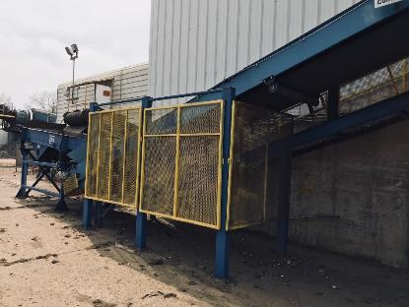
Conveyor Systems
Never wear loose clothing, hoods or other items that could get caught in moving parts.
Never crawl, reach, pry with a tool, or work under a conveyor that YOU have not locked out.
Never walk on or step over a conveyor.
Notes:
Conveyor Systems
Discuss the dangers of conveyors; the importance of machine guarding

Slide 40
Conveyor Systems
Notes:
Conveyor Systems
Discuss any issues that are known to have happened because of loose clothing or jewelry getting caught up in moving machinery.

Slide 41
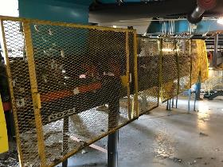
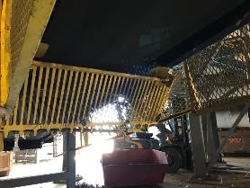
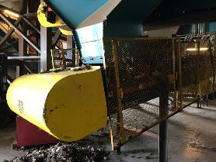
Machine Guarding examples
Notes:
Conveyor Systems
Discuss any issues that are known to have happened because of loose clothing or jewelry getting caught up in moving machinery.
Discuss the importance of keeping guarding clean and operational.

Slide 42
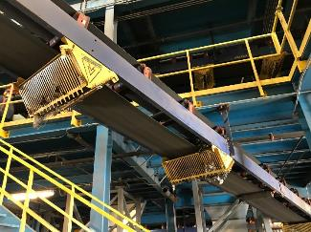
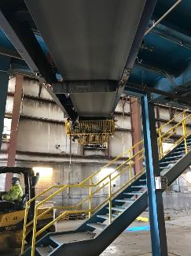
Machine Guarding examples
Notes:
Photos show options for guarding

Slide 43
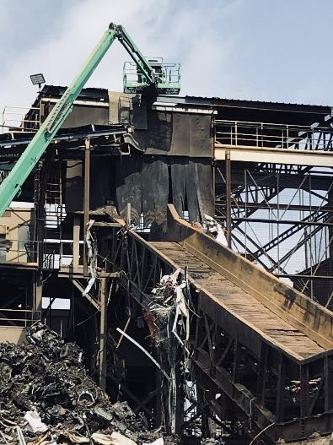
Machine Guarding examples
Guarding example at the top of a shredder in-feed. This type of guard is designed to prevent material from flying out of the shredder mill.
Notes:
Photo shows guarding being replaced or upgraded at a large shredder facility.

Slide 44
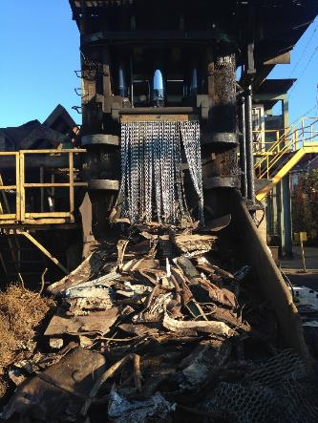
Machine Guarding examples
Mouth of Stationary Shear
Follow all manufacturer and OSHA guidelines for safe use and guarding of these tools.
Notes:
Guarding example at the mouth of a large shear

Slide 45
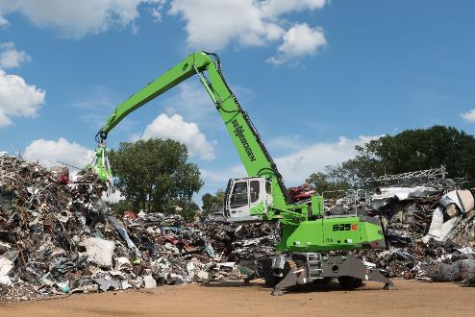
Machine Guarding examples
Point of operation guard
Railing system to prevent falls
Notes:
Guarding shown for an alligator shear and for a material handler.
The guards on the right block personnel from reaching in to moving parts (i.e., moving belts, fans, etc.).

Slide 46
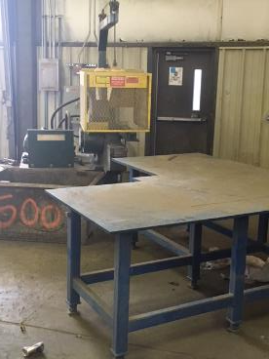
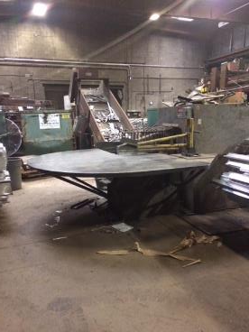
Machine Guarding examples
Table designed to act as distance guards
Notes:
Begin discussion of distance guarding

Slide 47
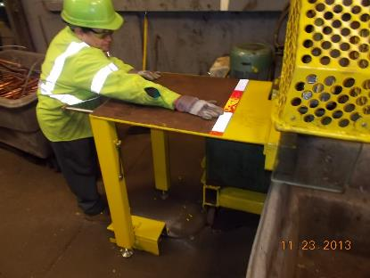
Machine Guarding examples
Example of guarding by distance
This adjustable table has been set-up to prevent the machine operator from getting too close to the point of operation.
Notes:
Continue discussion of distance guarding. These photos help to show this type of guarding in place and working.

Slide 48
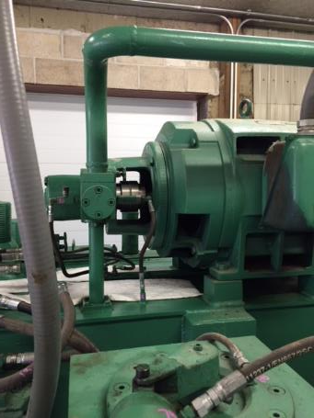
Machine Guarding examples
Better guarding solutions are needed in these areas
Notes:
Examples of exposure to moving hazards. This is a good time to discuss the hazards seen in these photos.

Slide 49
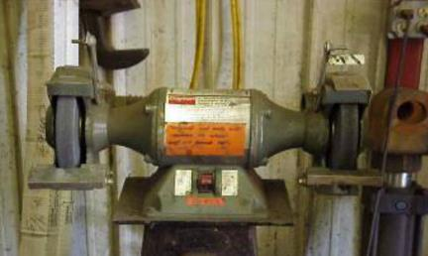
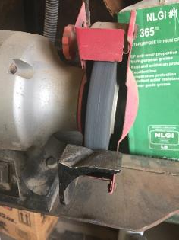
Machine Guarding examples
Bench Grinders
Follow all manufacturer and OSHA guidelines for safe use and guarding of these tools.
Notes:
¼” and 1/8” are the measurements for the work rest and the tongue guard.

Slide 50
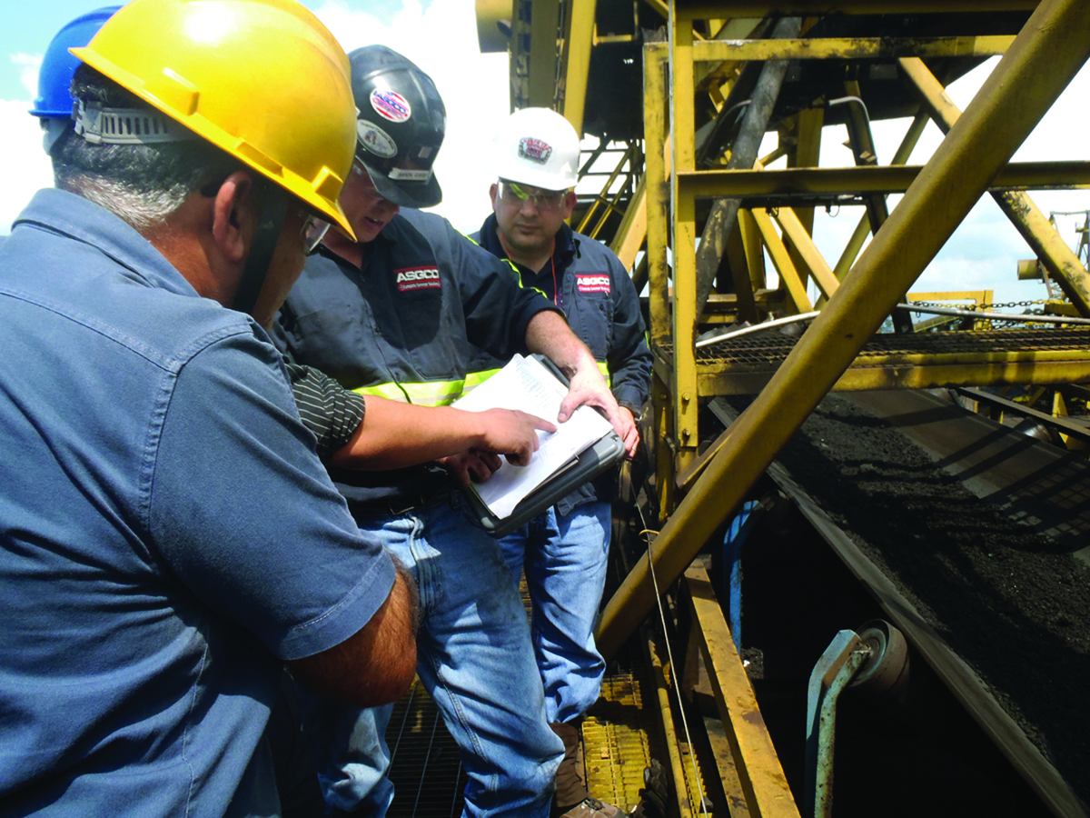
Hand Safety
Know the hand hazards of your working area.
They could be:
Electrical
Chemical
Heat or Cold
Handling sharp edged materials
Using knives or box cutters
Amputation
Notes:
Move in to a discussion on hand safety and why it is important to practice this at work and at home

Slide 51
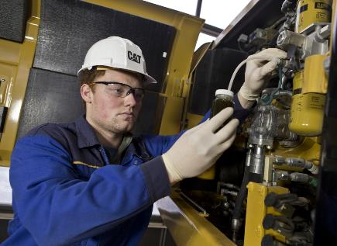
Hand Safety
Determine the Proper PPE and Safe Work Practices
Use proper tools to perform tasks; “no-touch” tool
Inspect and replace defective tools
Don’t wear rings, bracelets, or loose fitting clothing
Evaluate how chemicals are handled

Slide 52
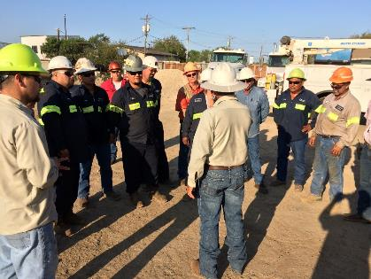
Hand Safety
Implement a Training Program and Discuss:
Types of hand hazards in the workplace
Types of injuries that can result
Safe work practices to minimize exposure to hazards
Know the proper types and fit of gloves to use
Notes:
Training

Slide 53
Hand Safety & Machine Guarding
Preview Video HERE
http://access.mtssafety.com/ISRI/vidISRI_HandSafety_R1.htm
http://www.mtssafety.com/
Notes:
This video has been produced for this training by MTS

Slide 54
Machinery Safeguards
Thank You,
Any questions or discussion?

