Slide 1
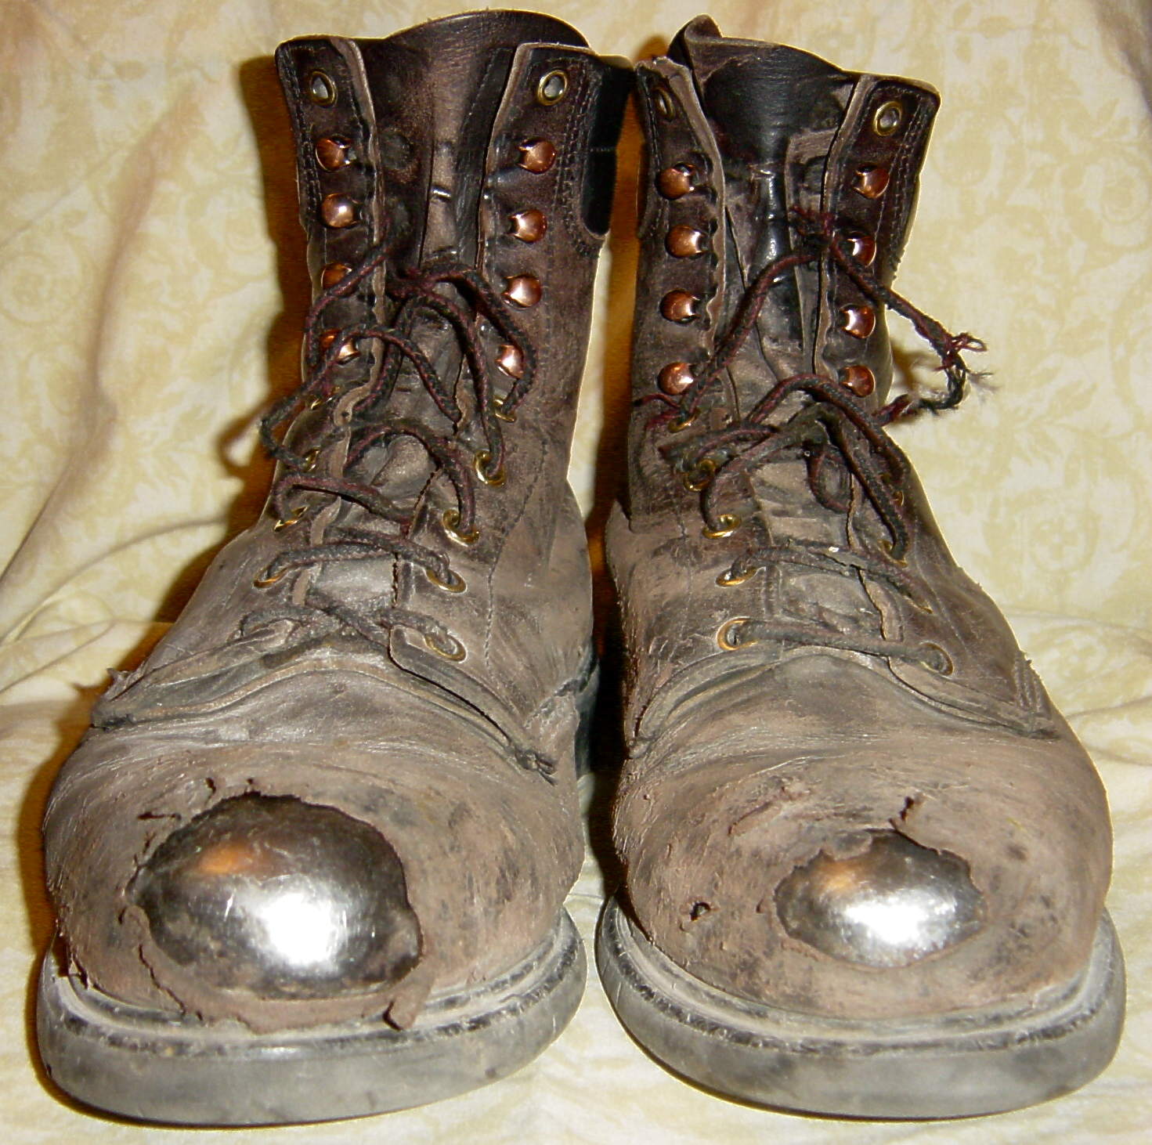
Personal Protective Equipment (PPE)
Joe Bateman ISRI Safety

Slide 2
Question:
When it comes to OSHA Compliance, is it enough to just make sure you have every worker in a hard hat, glasses, and steel-toed boots?

Slide 3
NO!
In a perfect world, you wouldn’t need any of that stuff.

Slide 4
The First Order of Business:
Do a Hazard Assessment:
Do you have hazards?
What are they?
How bad are they?
Where are they?
You’ve got to do something about them.

Slide 5
You must FIRST reduce/eliminate your hazards where possible.
What have you
already done
in these areas?

Slide 6
OSHA Says “Employers must:
Use all feasible engineering controls and work practice controls to eliminate and reduce hazards.”

Slide 7
ENGINEERING CONTROLS
If . . .
The machine or work environment can be physically changed to prevent employee exposure to the potential hazard,
Then . . .
The hazard can be eliminated with an engineering control.

Slide 8
ENGINEERING CONTROLS:
EXAMPLES—
Initial design specifications
Change process
Enclose process
Isolate process
Ventilation

Slide 9
WORK PRACTICE CONTROLS:
If . . .
Employees can be removed from exposure to the potential hazard by changing the way they do their jobs,
Then . . .
The hazard can be eliminated with a work practice control.

Slide 10
WORK PRACTICE CONTROLS:
EXAMPLES—
Use of wet methods to suppress dust
Personal hygiene
Housekeeping and maintenance
Job rotation of workers

Slide 11
Payment for PPE
When PPE is required to protect employees, it must be provided by the employer at no cost to employees, except for specific items, such as:
Safety-toe footwear
Prescription safety eyewear
Everyday clothing and weather-related gear

Slide 12
You must have a written PPE Program
Who wears it.
What do they wear.
When do they wear it.
Where do they wear it.
Why do they wear it.
How do they wear it.

Slide 13
TRAINING
You’ve got to train your people in these areas and document this training.
If you don’t write it down, it didn’t happen.

Slide 14
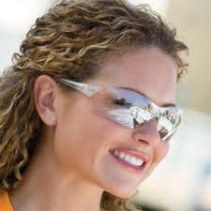
EYE PROTECTION
The most common PPE problem.
Take away the excuses.
Enforce it.
Lead by example.

Slide 15
TORCHMEN
At least Shade 5 eye protection.
Good gloves.
FR Greens or Leathers.
Safety Glasses.
Ear Plugs.

Slide 16
HEAD PROTECTION
Do you have overhead hazards?
If so, you need a hard hat.
Period

Slide 17
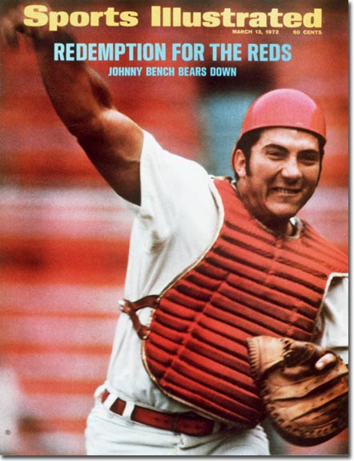
HEAD PROTECTION
Unless you’re
Johnny Bench,
don’t wear your
hard hat like him.
http://www.osha.gov/pls/oshaweb/owadisp.show_document?p_table=INTERPRETATIONS&p_id=24365

Slide 18
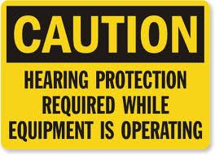
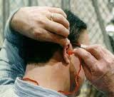
HEARING PROTECTION
Do a noise level test.
Enforce the use of ear plugs or muffs.
Put up signs.
Encourage torchmen to use them.

Slide 19
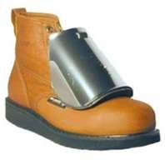
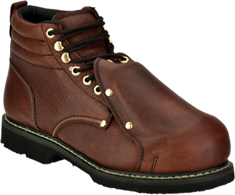
FOOT PROTECTION
Most companies help out.
Metatarsal guards.
Steel shanks.
Sneaker look-alikes?

Slide 20
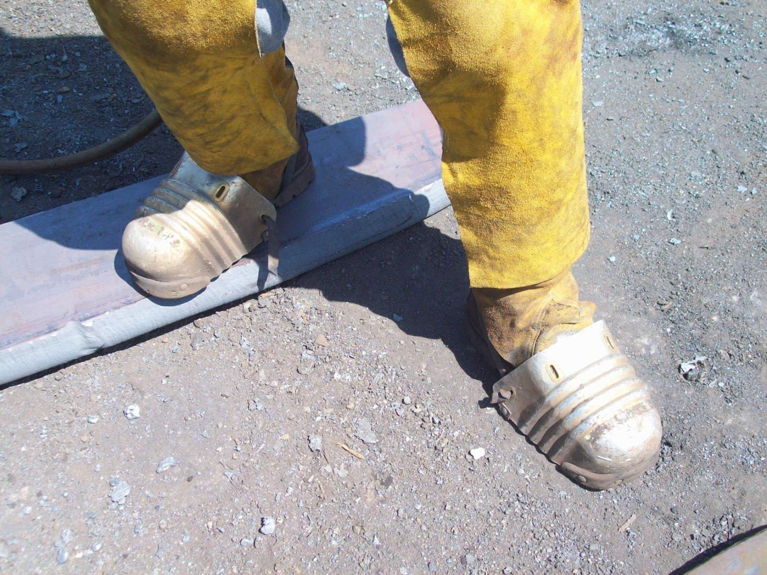
Here’s one option for protecting torchmen’s feet.
What are some others?

Slide 21
HAND PROTECTION
One of the most common scrap yard injuries.
Get the right gloves for the job.
What’s the hazard?
Protect against it.
Reconditioning.

Slide 22
Bob Bedard
PH: 330-343-5565 ext 201
FAX: 330-364-8094
EMAIL: bob@nascoop.com

Slide 23
SUMMARY
Assess the workplace for hazards
Use engineering and work practice controls to eliminate or reduce hazards before using PPE
Select and provide appropriate PPE to employees to protect them from hazards that cannot be eliminated
Inform employees why the PPE is necessary and when it must be worn
Train employees how to use and care for their PPE
Require employees to wear selected PPE in the workplace

Slide 24
Questions?
Joe Bateman
615-517-2251
joebateman@isri.org
www.isrisafety.org
www.isri.org

