Slide 1
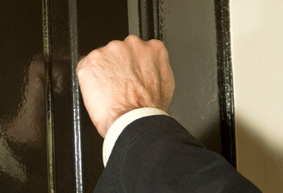

When OSHA comes a’knockin . . .
Joe Bateman
ISRI Safety Outreach Manager

Slide 2
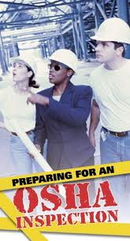
OSHA Inspections
What will bring them?
  Complaint
  Random
  Death/Catastrophe
  Media
  Emphasis Program
  Drive By

Slide 3
OSHA Region VI
(AR, LA, NM, OK, TX)
Emphasis Programs:
Demolition
Metal Fabrication
Noise
Fall Hazards
Heat Illness

Slide 4
Introduction
Be Respectful
Credentials
Opening Conference
4 Hours to produce people or records.
Know where your records are.

Slide 5
Walk Through
Limit scope
“Code Blue”
Pictures
Right to interview employees privately
“Plain View” hazard is fair game
Air sampling

Slide 6
Closing Conference
Discuss issues, take notes
Present compliance-related documentation
Follow company protocol re: legal counsel
Attorney/Client privilege

Slide 7
What Happens After an OSHA Inspection?
OSHA may or may not issue citations.
Standards allegedly violated.
Abatement deadlines.
Post copy of citation 3 days or until violation is corrected.
Notes:
- After CSHO reports findings, the area director determines what citations, if any, will be issued, and what penalties, if any, will be proposed.
- Citations and notices of proposed penalties are sent by certified mail.

Slide 8
Post Inspection
Informal Conference
  Informal meeting to discuss inspection issues
  15 working day contest period limitation
  Both parties, including legal counsel, can participate

Slide 9
Verification of Records
Incident reports
First-aid logs
Disciplinary records pertaining to injuries and illnesses.
OSHA 300 Logs
OSHA 300A

Slide 10
Example Recordkeeping Citations
Failure to :
Record injuries or illnesses on the OSHA 300 form.
Record a case correctly
Adequately describe the location
Provide a specific description
Enter the correct number of calendar days
Not completing or not accurately completing the OSHA 301
Complete an OSHA 300A
Provide copies of records

Slide 11

OSHA’s Most Cited Standards
1. Lockout
2. Forklifts
3. Electrical
4. Machine Guarding
5. Confined Spaces
6. HazCom
7. General Duty Clause
8. Holes
9. Electrical
10. Lead

Slide 12
OSHA News Release
The U.S. Department of Labor's Occupational Safety and Health Administration has cited metals recycler (name withheld) with 17 alleged health and safety violations, including allowing workers to exceed allowable exposure limits to lead and failing to require respirators to be worn. The citations carry total penalties of $135,850.

Slide 13
OSHA News Release
The U.S. Department of Labor's Occupational Safety and Health Administration has issued citations to (name withheld) for exposing workers to lead hazards at its site. Proposed penalties total $188,500.

Slide 14
What is
Hexavalent Chromium?
Toxic form of chromium metal that is generally man-made
Used in many industrial applications
primarily for its anti-corrosive properties
Can be created during certain “hot” work processes where the original form of chromium was not hexavalent

Slide 15
A Success Story
“I saved a guy $5,000 the other day.”

Slide 16
A Sad Story
“I could have saved a guy $40,000 the other day.”

Slide 17

The Future of OSHA
Combustible Dust reg coming.
Ergonomics
Bigger fines
More bad publicity
“Pray for the dead
and fight like hell
for the living.”
--Mother Jones

Slide 18
Questions?
Joe Bateman
202-716-3702
joebateman@isri.org

