Slide 1
Safety: How to Create & Run a Safety Program in Today’s Scrap Yard
Joe Bateman
ISRI Safety Outreach Manager

Slide 2
What elements do you need?
Hazard Assessment
Accident Reporting and Investigation
First Aid/DPR/AED
Bloodborne Pathogens
Compressed Gas
Confined Space Entry
Corporate Safety Policy
Electrical Safety
Contractor Safety
Emergency Action Planning
Fall Protection
Fire Prevention
Forklift Operation
Hazard Communication
Hearing Conservation
Lockout/Tagout
Personal Protective Equipment
Respiratory Protection
Welding and Cutting

Slide 3
Hazard Assessment
The First Order of Business.
PPE is Last Resort.
Make it simple.
Document.
http://www.osha.gov/Publications/osha3071.pdf

Slide 4
Accident Reporting & Investigation
Tell me.
Tell me now.
Write it down.
_____________________________________
_____________________________________

Slide 5
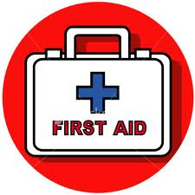
First Aid/CPR/AED
Let the experts do it.
Use local talent.
First Aid Logs.

Slide 6
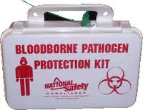
Bloodborne Pathogens
We’ve got kits.
Here’s where they are.
Here’s how to use them.
Here’s how to dispose of them.
Don’t put your hands in somebody else’s blood.

Slide 7
Compressed Gas
Keep every cylinder secured.
Always upright.
If refilling, train.
__________________________________
__________________________________

Slide 8
Confined Space Entry
Don’t crawl in a hole unless you know what’s in there.
Mark ‘em.
Train—thoroughly.
Have a way out.

Slide 9
Electrical Safety
You’re not an electrician.
“A man’s gotta know his limitations.”
--Clint Eastwood

Slide 10
Contractor Safety
Hold your contractors to the same standard you do your own people.
_______________________________________
_______________________________________
_______________________________________

Slide 11
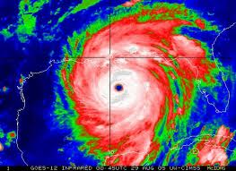
Emergency Action Planning
Fires
Tornadoes
Floods
Hurricanes
Earthquakes
Volcanoes
Blizzards

Slide 12
Fall Protection
4 Feet off the ground
Tie off in the JLG
Hand rails in good condition
Chains across loading docks

Slide 13
Fire Prevention
How do you tell everyone?
Where do you go?
Who counts heads?
Hands on fire extinguisher training.
_____________________________________

Slide 14
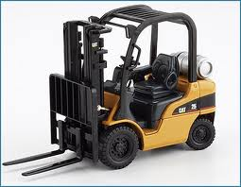
Forklift Operation
Train your operators.
Write it down.
Wear the seat belt.
Inspect.
______________________________________

Slide 15
Hazard Communication
MSDS
Labels
_________________________________
_________________________________
_________________________________

Slide 16
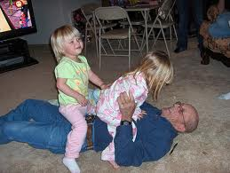
Hearing Conservation
Test the noise.
Reduce/eliminate the noise.
Protect your people.
Test your people.

Slide 17
Lockout/Tagout
Assess the Hazards.
Know your equipment.
Figure it out.
Add or move LOTO points, if needed.
Write it down: Simple.
Train, Train, Train.
Enforce—No Exceptions, No Shortcuts.
Save Lives.

Slide 18
Personal Protective Equipment
Assess the Hazards.
Eliminate/Reduce the Hazards.
Protect your people (sometimes from themselves).
Lead by example.

Slide 19
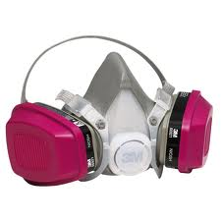
Respiratory Protection
Why?
How to know.
Voluntary vs. Mandatory.
Fit Test.
Keep ‘em clean.
Notes:
Add Appendix D of Respiratory Standard here.

Slide 20
Welding & Torch Cutting
Lead
Air sampling
Blood Lead
Zinc Protoporphyrin (ZPP)
Hoses

Slide 21
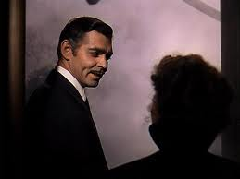
You’ve got to give a damn.

Slide 22
Questions?
Joe Bateman
202-716-3702
joebateman@isri.org

