Slide 1

Is there a Grizzly
in your
Confined Space?

Slide 2

Maybe not,
But that’s how we should treat them.

Slide 3
Why do we have a Confined Space standard?
122 confined space accidents each year lead to 176 fatalities.
60% of the fatalities occurred during rescue attempts.

Slide 4
Intended to protect workers from:
  toxic, flammable, explosive, or asphyxiating atmospheres
  possible engulfment
  any other recognized serious hazard (e.g. - hazardous energy)
The standard focuses on areas with immediate health or safety risks, denoting them as “Permit Required Confined Space”

Slide 5
In other words:
When it comes to confined spaces, you’re guilty until proven innocent.
OSHA assumes every confined space you have requires a permit to get into unless you prove otherwise.
You’ve got to prove AND document the status of every confined space on your property.

Slide 6
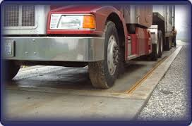
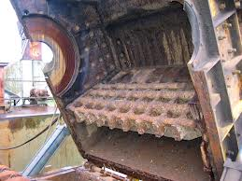
Common Confined Spaces
Scale Pit
Shredder
Baler/Logger
Bag House
Oil/Water Separator
Tank
Z-box

Slide 7
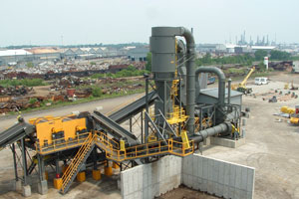
Cyclone

Slide 8
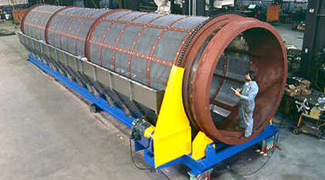
Trommel

Slide 9
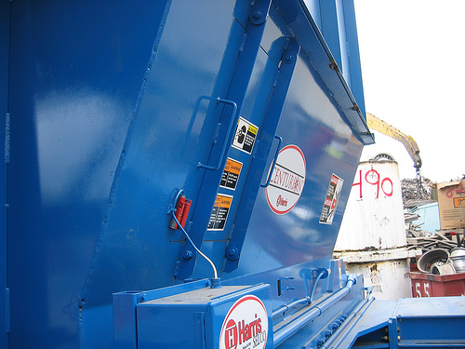
Baler Access Door

Slide 10
How to Identify Confined Spaces
Limited Openings for Entry and Exit; AND
Is large enough and so configured that an employee can bodily enter and perform assigned work; AND
Not Designed for Continuous Worker Occupancy

Slide 11
Definition of “Bodily Enter”
Bodily enter means the action by which a person passes through an opening into a confined space. Entry includes ensuing work activities in that space and is considered to have occurred as soon as any part of the entrant's body breaks the plane of an opening into the space.

Slide 12
Dangerous Combinations
Presence of all three confined space characteristics can complicate the situation.
Working in and around the space.
Rescue operations during emergencies.
Worsened conditions due to work activities:
  Welding and cutting
  Cleaning with solvents, use of other chemicals
  Use of gas-powered equipment

Slide 13
Permit Required Confined Space
Contains or has a potential to contain a hazardous atmosphere;
Contains a material that has the potential for engulfing an entrant;
Has an internal configuration such that an entrant could be trapped or asphyxiated by inwardly converging walls or by a floor which slopes downward and tapers to a smaller cross section; or
Contains any other recognized serious safety or health hazard.

Slide 14
Permit-Required Confined Space
Confined Space
Limited Openings for Entry & Egress
Large enough to bodily enter and perform work
Not designed for continuous worker occupancy
Hazardous atmospheres
Engulfment
Trapped or asphyxiated by inwardly converging walls or by a floor
Contains any other recognized serious safety or health hazard
Notes:
Side by side comparison.

Slide 15
Hazardous Atmosphere
Flammable gas, vapor, or mist in excess of 10% of its lower flammable limit (LFL);
Airborne combustible dust at a concentration that meets or exceeds its LFL;
Atmospheric oxygen concentration below 19.5% or above 23.5%;
Atmospheric concentrations of any substance for which a dose or PEL is published in Subpart G or Z of this Part and which could result in employee exposure in excess of its dose or PEL;
Any other atmospheric condition that is IDLH

Slide 16
Employers are required to evaluate workplaces to determine if any spaces are permit-required confined spaces.

Slide 17

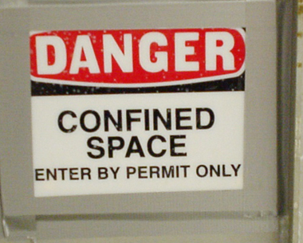
Signs
Employees must be informed of the existence of confined spaces through the use of signs and/or labels.

Slide 18
Entering Permit Spaces
If employees will enter permit spaces, the employer shall develop and implement a written permit space program
The written program shall be available for inspection by employee and their authorized representatives

Slide 19
Contractor
  Obtain any available information regarding permit space hazards and entry operations
  Coordinate entry operations with host employer
  Inform the host employer of any hazards confronted or created in permit spaces, either through debriefing or during entry operations

Slide 20
Hazards of Confined Spaces
Oxygen Deficient Atmospheres
Oxygen Enriched Atmospheres
Flammable Atmospheres
Toxic Atmospheres
Temperature Extremes
Engulfment Hazards
Noise, Slick/Wet Surfaces, Falling Objects

Slide 21
Oxygen Deficient Atmospheres
  19.5 % Minimum acceptable oxygen level.
  15 - 19% Decreased ability to work strenuously. Impair coordination. Early symptoms.
  12-14% Respiration increases. Poor judgment.
  10-12% Respiration increases. Lips blue.
  8-10% Mental failure. Fainting. Nausea Unconsciousness. Vomiting.
  6-8% 8 minutes - fatal, 6 minutes - 50% fatal 4-5 minutes - possible recovery.
  4-6% Coma in 40 seconds. Death

Slide 22
Oxygen Deficient Atmospheres
Exposure to atmospheres containing 12% or less oxygen will bring about unconsciousness without warning and so quickly that individuals cannot help or protect themselves.

Slide 23

Oxygen Enriched Atmospheres
Oxygen level above 23.5%.
Causes flammable and combustible materials to burn violently when ignited.
Hair, clothing, materials, etc.
Oil soaked clothing and materials.
Never use pure oxygen to ventilate.
Never store or place compressed tanks in a confined space.

Slide 24
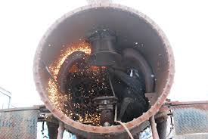
Flammable Atmospheres
The byproducts of work procedures can generate flammable or explosive conditions within a confined space.

Slide 25
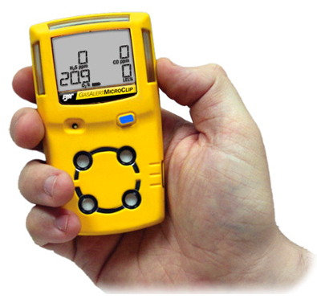
Confined Space Testing
FOUR-GAS DETECTOR
Oxygen content
Flammability / explosion potential
Carbon monoxide
Hydrogen sulfide
CRITICAL ISSUES
Training
Procedures
Calibration

Slide 26
Testing The Atmosphere
Verify presence of safe work atmosphere.
Test all areas of a confined space.
  Top, Middle, Bottom
Methane is lighter than air.
Carbon Monoxide is the same as air.
Hydrogen Sulfide is heavier than air.
Oxygen Deficiency.

Slide 27
Lockout/Tagout
First option to eliminate hazards.
Locking and tagging out electrical sources.
Blanking and bleeding pneumatic and hydraulic lines.
Disconnecting mechanical drives and shafts.
Securing mechanical parts.
Locking and tagging out shutoff valves.

Slide 28
Ventilation
Must be aware of hazards you are trying to correct in the confined space.
Air intake in a safe location to draw fresh air only.
Continuous ventilation whenever possible.
Retest the confined space before entry.

Slide 29
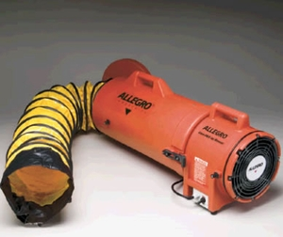
Ventilation Option

Slide 30
Engulfment Hazards
Material on Feed conveyors
Fluff
Flooding of confined space.
Water or sewage flow.

Slide 31
Authorized Entrants
Entrants must:
  Know the hazards they are facing
  Be able to recognize signs and symptoms of exposure
  Understand the consequences of exposure to hazards
  Communicate with attendants as necessary
  Alert attendants to warning signs or existence of a hazardous condition
  Exit when ordered or alerted

Slide 32
Attendants
Attendants must:
  Be aware of behavioral effects of potential exposures
  Maintain count and identity of entrants
  Remain outside the space until relieved
  Communicate with entrants
  Monitor activities inside and outside the space and order exit if required

Slide 33
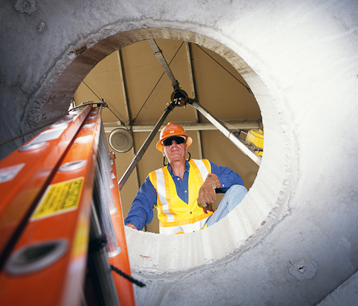
Attendants (cont)
Attendants must:
  Summon rescuers is necessary
  Prevent unauthorized entry
  Perform non-entry rescue
  Attendants may NOT perform other duties
  that interfere with their primary duty
  to monitor and protect!

Slide 34
Entry Supervisors
Entry Supervisors must:
  Issue confined space permits
  Know hazards
  Verify that all tests have been conducted
  Verify that all procedures and equipment are in place before signing a permit
  Terminate entry if necessary and cancel permits

Slide 35
Entry Supervisors (cont.)
  Verify availability of rescue services and means for summoning them
  Remove unauthorized individuals, terminate entry if necessary, and cancel permits
  Coordinate shift change

Slide 36
Permit Entry Systems
Written permit signed by entry supervisor.
Verifies pre-entry precautions have been taken and the space is safe to enter.
Posted at entry to confined space.
Specifies apparent hazards and corrective actions taken prior to entry.
Requires termination of permit when task is completed or when new conditions exist.

Slide 37
Entry Permit Requirements
Date, location, and name of confined space.
Purpose of entry and known hazards.
Duration of entry permit time.
Authorized entrants, attendants, supervisors.
Air testing results - signature of tester.
Protective measures to be taken.
    Ventilation, Isolation, Flushing
    Lockout / Tagout, Purging

Slide 38
Entry Permit Requirements
Name and phone numbers of rescue and emergency services.
Communication procedures.
Special equipment and procedures.
    Personal protective equipment.
    Alarm procedures.
    Rescue equipment.
    Respirators.

Slide 39
Training and Education
All workers who must enter confined spaces
All attendants and rescue team members.
Prior to initial work assignment.
Retraining:
    Job duties change.
    Change in permit-space program.
    New hazards are present.
    Job performance indicates deficiencies.

Slide 40
Training and Education
Training and emergency drills should be conducted once a year or whenever the procedure or process changes
Records for training must include:
  Name of employee(s)
  Signature of trainer(s)
  Date(s) of training and
  Must be retained for 3 years

Slide 41
Sample Confined-Space
Entry Permit

Slide 44
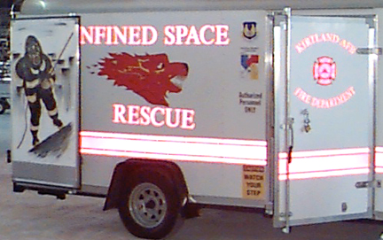
RESCUE

Slide 45
The Necessity of Rescue
Entrants are in spaces that could quickly render them unconscious
Over 60% of fatalities in confined spaces are would-be rescuers
A pre-planned and effectively executed rescue saves lives
Entry programs that by-pass safeguards will eventually end up requiring rescue

Slide 46
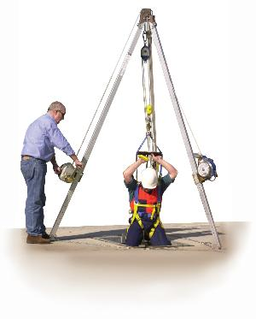
Rescue Members are Trained:
To perform assigned duties
As entrants
In first aid and CPR (at least one member holds current certification)
To be proficient in use of personal protective equipment
To practice rescue at least once every 12 months

Slide 47
Questions?
THANK YOU!
Joe Bateman
ISRI Safety
joebateman@isri.org
615-517-2251

