Slide 1
Strengthening the Culture of Safety in the Scrap Recycling Industry
Robin Wiener, ISRI President
ASLRRA Short Line Safety Institute
Railroad, Safety and Education Forum (Washington DC)
September 10, 2015

Slide 2
Overview
Introduction
  ISRI
  Snapshot of the Scrap Recycling Industry
Safety: Setting the Stage
  Our challenge
  Process towards a new approach
Circle of Safety Excellence™
  What is it
  The experience one year in
  Other initiatives

Slide 3
Introduction

Slide 4
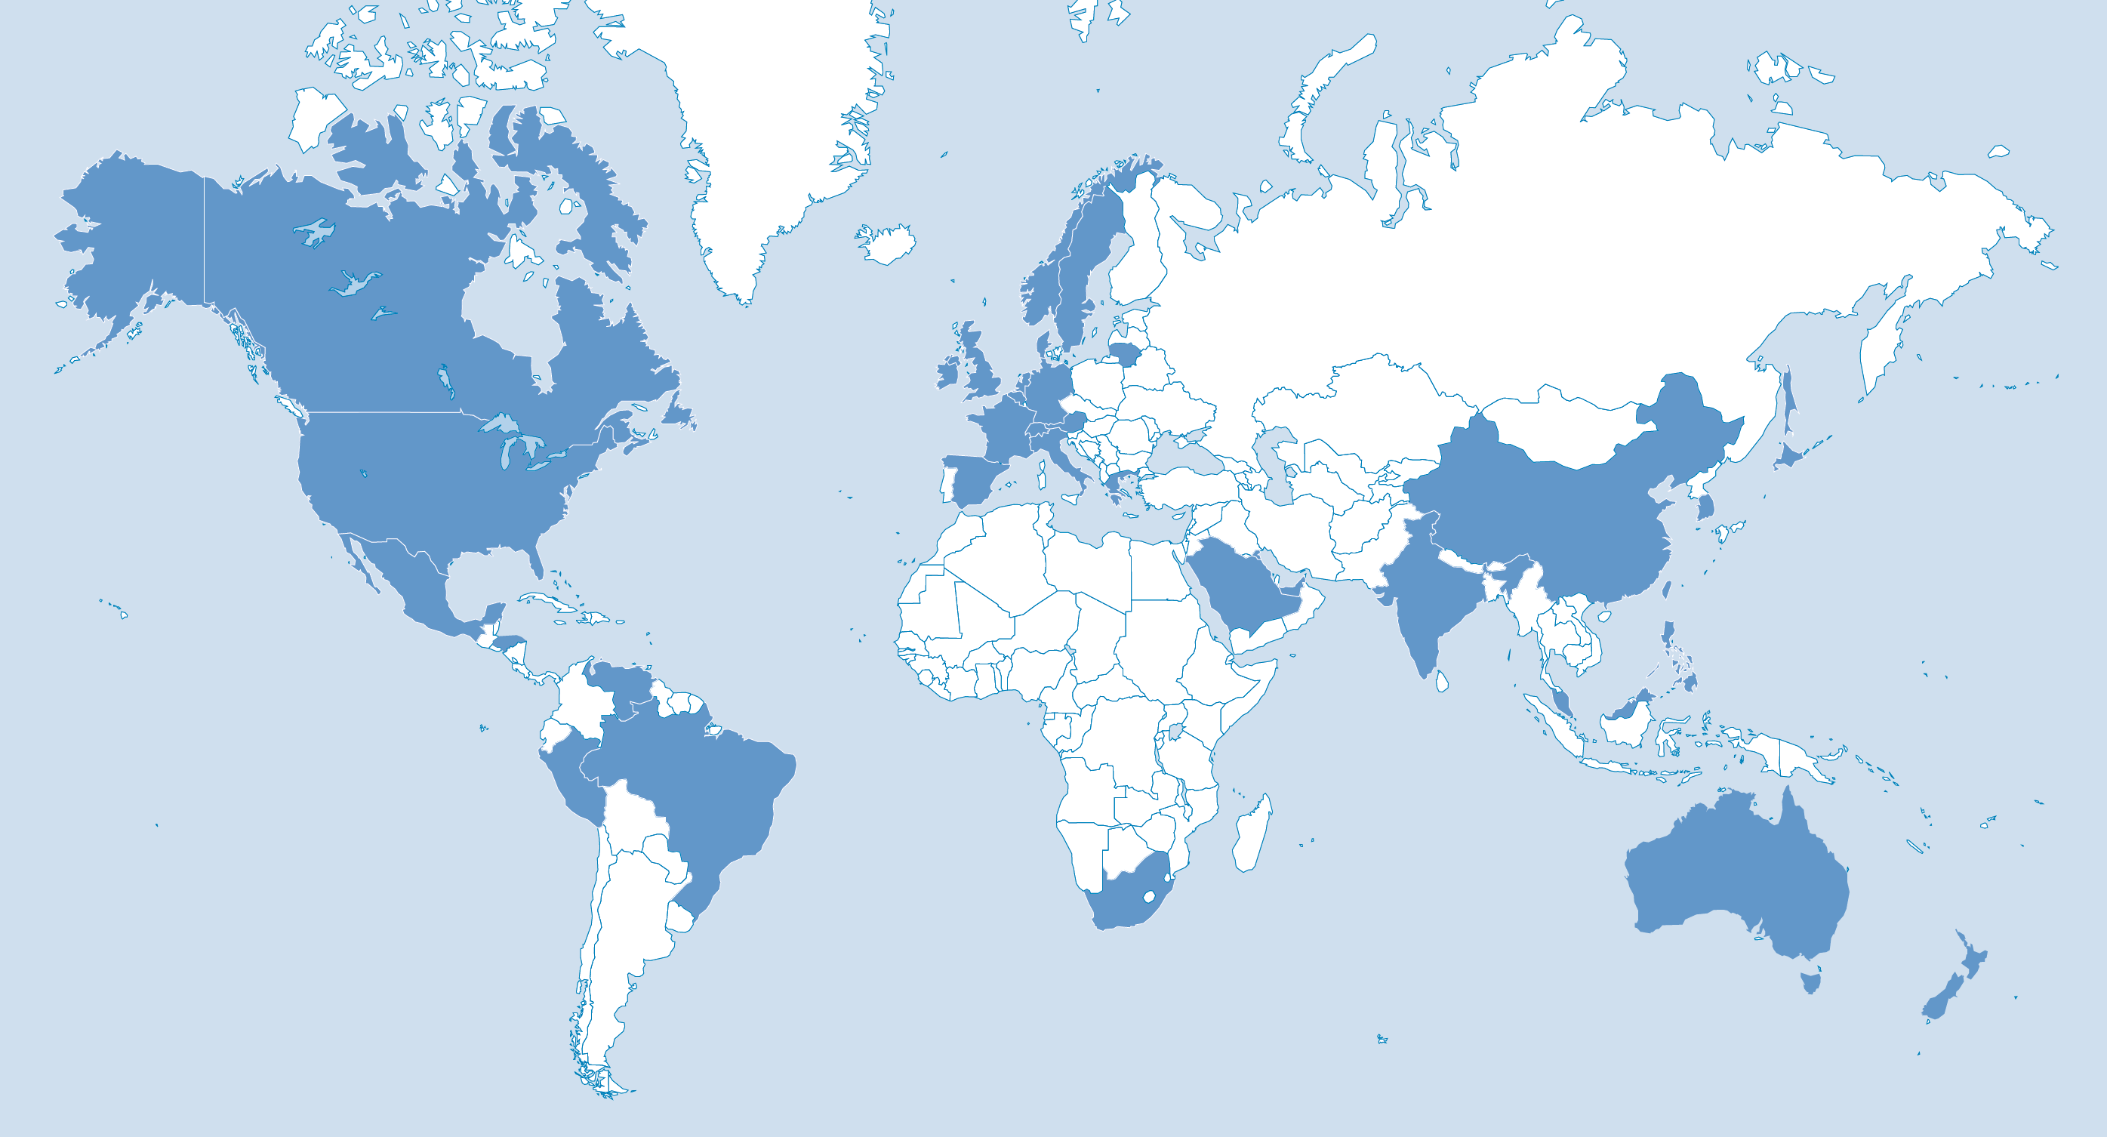
ISRI: Voice of the Recycling Industry
1,500+
Member companies
7,000+
Recycling facilities worldwide
34
Countries
Notes:
Institute of Scrap Recycling Industries (ISRI)
ISRI is an international trade association that represents more than 1,700 member companies that process, broker and consume scrap (ranging from small, family-owned businesses to large, multi-national corporations)
Representing 7,000+ facilities worldwide - that process, broker & consume scrap metals, paper, plastics, glass, textiles, rubber, and electronics.

Slide 5







Institute of Scrap Recycling Industries
Ferrous &
non-ferrous metals
Paper
Plastics
Glass
Rubber
Textiles
Electronics

Slide 6
U.S. Recycling Industry Snapshot
$105 Billion Industry
149,000 472,000
Direct Employees Induced
135,000,000
Tons processed annually
Part of the larger global industry
40 MMT $21B 160 Total exported Value Countries to which
recyclables are
sold
Tons processed annually
Notes:
Recycling Globally
U.S. is the world’s largest scrap exporter.
51 million metric tons exported.
The value of exported materials is $39 billion in 158 countries.

Slide 7
U.S. Recycling Industry Snapshot
Industry’s success is dependent upon our ability to safely, effectively and efficiently move our product so I am grateful for the dialogue & opportunity to share experiences
Notes:
Recycling Globally
U.S. is the world’s largest scrap exporter.
51 million metric tons exported.
The value of exported materials is $39 billion in 158 countries.

Slide 8
Safety: Setting the Stage

Slide 9

ISRI: Safely of Not at All
Ensuring the safety of our employees, and all those who enter a scrap yard has long been a priority for ISRI
For 25+ years, ISRI provided a traditional, passive safety program
  Videos
  Posters
  Workshops, etc…
10 years ago, shifted to a more pro-active program
  On-Site, one on one “blueprint program”
  Addition of a transportation safety focus approx. 6 years ago based on industry loss data showing 25% of losses related to transportation risks
  But we continue to struggle with how to “move the needle.”
Notes:
Recycling Globally
U.S. is the world’s largest scrap exporter.
51 million metric tons exported.
The value of exported materials is $39 billion in 158 countries.

Slide 10
New Approach Needed
Industry leaders brought together in early 2014 to have a thoughtful & deliberate discussion on what ISRI can & should do to help members address the issue of workplace safety more effectively.
They asked themselves 3 questions:
What Problem(s) are we trying to Solve?
What would success look like?
How do we get from problem to success?
Notes:
Recycling Globally
U.S. is the world’s largest scrap exporter.
51 million metric tons exported.
The value of exported materials is $39 billion in 158 countries.

Slide 11
What Problem(s) are we Trying to Solve?
  No single problem, but a combination of many …
  The Recycling Industry is a Safe Industry IF ….
  Member Apathy/Outliers
  Safety Creep
  Lack of Management/Owner Commitment
  Lack of Proper Industry Metrics & Data
  Lack of Strong External Driver
  Communications
  Industry Competition
Notes:
Recycling Globally
U.S. is the world’s largest scrap exporter.
51 million metric tons exported.
The value of exported materials is $39 billion in 158 countries.

Slide 12
What Does Success Look like?
To understand what we are trying to achieve, envisioned the following reality for the industry 10 years from now…
The term “deadliest” no longer used to describe the industry
Ratio of outliers to engaged members is flipped
Continuous improvement approach throughout the industry
Zero Tolerance permeates all within the industry
Leadership by example
Common industry safety benchmarks established
Use of metrics would lead to solutions
Safety messages communicated to all layers within all companies
Safety on par with operations & other key aspects of the business
Notes:
Recycling Globally
U.S. is the world’s largest scrap exporter.
51 million metric tons exported.
The value of exported materials is $39 billion in 158 countries.

Slide 13
To Get From Problems to Success….
A problem as complex as how to drive & create a safer industry requires a series, or family, of solutions
Multi-year strategy i.e., little can happen overnight, or even in one year
Menu of solutions developed, including annual safety week, a Book of 1001 Safety Ideas, new safety communications, cooperative efforts with OSHA, among many, many other ideas
One idea surfaced to the top as a priority: formation of a Circle of Safety ExcellenceTM, open to all members committed to safety, who would effectively lead by example.
Notes:
Recycling Globally
U.S. is the world’s largest scrap exporter.
51 million metric tons exported.
The value of exported materials is $39 billion in 158 countries.

Slide 14
Circle of Safety Excellence™

Slide 15
The Circle of Safety Excellence™
  What is the Circle of Safety Excellence™?
  Initiative to help improve worker safety in the recycling industry
  Goal: create a smart, effective & sustainable program that grows over time to eventually encompass everyone within ISRI
  Benefits: benchmarking, sharing of best practices, mentoring
Notes:
Recycling Globally
U.S. is the world’s largest scrap exporter.
51 million metric tons exported.
The value of exported materials is $39 billion in 158 countries.

Slide 16
The Circle of Safety Excellence™
Anticipated Benefits of being a member of the Circle …
  Benchmarking
  Network of companies committed to safety
  Sharing best practices
  Recognition

Slide 17
The Circle of Safety Excellence™
Obligation of Circle Members to Help Others
As a group of like-minded companies committed to not only improving safety at their own operations, but also within the industry as a whole, it is expected that Circle members will:
  Openly share best practices with others
  If asked, visit/invite other companies to see their operation & associated safety systems
  Be willing to assist/encourage enrollment in the Circle
  Report outcomes of all outreach efforts to the Circle Steering Committee

Slide 18
The Circle of Safety Excellence™
Must have the following safety programs in place and agree to random verification:
Alcohol/Substance Abuse
Bloodborne Pathogens
Confined Space
Driver Training
Fall Protection
Fire Prevention
Fleet Management Safety
Forklift/Mobile Equipment operation
Hazard Communication
Hot Work Permit
Housekeeping
Incident Investigation
Industrial Hygiene evaluation (air & noise monitoring)
Lockout/Tagout & Electrical Safety
Machine Guarding
New Hire safety orientation/training
Person responsible for safety
Personal Protective Equipment (PPE)
Recordkeeping
Visitor Safety Control
These written programs are foundational elements of a company’s safety program.

Slide 19
The Circle of Safety Excellence™
  What if I do not have all of these safety programs in place?
  ISRI is committed to providing the resources to assist any interested company achieve the milestones required for membership in the Circle. Working to create a peer to peer network, as well as an even stronger resource team through the ISRISafety Staff.
Notes:
What if I do not have all of these safety programs in place at my business?
ISRI is committed to providing the resources to assist any interested company achieve the milestones required for membership in the Circle of Safety Excellence™

Slide 20
The Circle of Safety Excellence™
  What Data is Shared?
LTI (Lost Time Injury Frequency Rate)
DART (Days Away, Restricted work activity and/or Job Transfer)
TCIR (Total Case Injury Rate)
CSA data (if your company has a fleet)
(additional voluntary submittal: workers compensation “experience modifiers”)
Notes:
Recycling Globally
U.S. is the world’s largest scrap exporter.
51 million metric tons exported.
The value of exported materials is $39 billion in 158 countries.

Slide 21
The Circle of Safety Excellence™
Frequency of Data Submission:
  Annual Data Submission to ISRI
  Initially, 3 years of historical data required
Data kept confidential
  Members can opt to reveal names with data
  Otherwise companies will only be identified through a key
  ISRI will reach out to members whose numbers look high to offer assistance
Notes:
Recycling Globally
U.S. is the world’s largest scrap exporter.
51 million metric tons exported.
The value of exported materials is $39 billion in 158 countries.

Slide 22
The Circle: One Year In
  Profile of Current Circle Membership:
  98 Companies representing 804 facilities
  Represent 26% of ISRI member facilities
  Big & small:
    66% report < 3 facilities
    15% report > 11 facilities
  Across all commodities
Notes:
Recycling Globally
U.S. is the world’s largest scrap exporter.
51 million metric tons exported.
The value of exported materials is $39 billion in 158 countries.

Slide 23
The Circle: One Year In
  Next Steps:
  Verification Program
  Work Groups being formed
    Mentoring non-Circle members
    Defining/creating safety culture
    Fatality prevention initiatives
    Risk assessment/job safety analysis
    Safety management systems
    New hire orientation
    Leading indicators
    Measuring dollar savings from a safety culture
  Down the road: differing levels of membership
Notes:
Recycling Globally
U.S. is the world’s largest scrap exporter.
51 million metric tons exported.
The value of exported materials is $39 billion in 158 countries.

Slide 24
The Circle: One Year In
  Challenges:
  Resources
  Determining the right data to collect
    Leading vs lagging indicators
    Near misses
  Strength of verification program
    Need to balance potential liabilities
  How to Measure Success
Notes:
Recycling Globally
U.S. is the world’s largest scrap exporter.
51 million metric tons exported.
The value of exported materials is $39 billion in 158 countries.

Slide 25


Other Safety Initiatives
  Annual Industry Wide Safety Stand-Down Day
  Outreach services
  Train-the-trainer programs
  Alliance with OSHA
  ISEC (ISRI Safety & Environment Council)
  Safety Resources Catalogue
  Transportation Safety Award program
  RIOS™
Notes:
Recycling Globally
U.S. is the world’s largest scrap exporter.
51 million metric tons exported.
The value of exported materials is $39 billion in 158 countries.

Slide 26
Work Together Across Industries
  Important Opportunity to Share/Exchange Information on Common Safety Issues
  Speak/train recyclers at scrap facilities on issues related to rail safety
  Are there any ASLRR training programs that a scrap recycling industry person can attend?
  Does ASLRRA have any Best Practice sheets that can be shared related to the movement of rail cars?
    What is the best practice? With a shunter/small locomotive with a positive braking system? Alternatives to using wheel loaders and/or material handlers that can damage the rail cars.
  Invitation to speak on rail safety at a future ISEC meeting
  Other ideas?
Notes:
Recycling Globally
U.S. is the world’s largest scrap exporter.
51 million metric tons exported.
The value of exported materials is $39 billion in 158 countries.

Slide 27
Thank You
Robin K Wiener
robinwiener@isri.org
202 662-8512
www.isri.org; www.isri.org/safety

