Slide 1
Used Electronic Products (UEPs)
& Waste
Robin Wiener
President, ISRI
Bloomberg BNA Webinar: UEPs & Waste:
To Export or Not Export
June 18, 2013

Slide 2
Overview
ISRI
Snapshot: U.S. Recycling Industry
UEPs & Export
Role of Industry Certification
Notes:
Institute of Scrap Recycling Industries (ISRI)
As the Voice of the Recycling Industry, ISRI represents the needs of its members including: manufacturers, processors, brokers and industrial consumers of scrap commodities
ISRI provides a variety of services to its members, including:
Promoting responsible industry practices
Helping shape domestic and international recycling policy
Providing continuous industry research
Offering resources to members to improve operations, including various training sessions

Slide 3
Institute of Scrap Recycling industries, Inc.

Slide 4
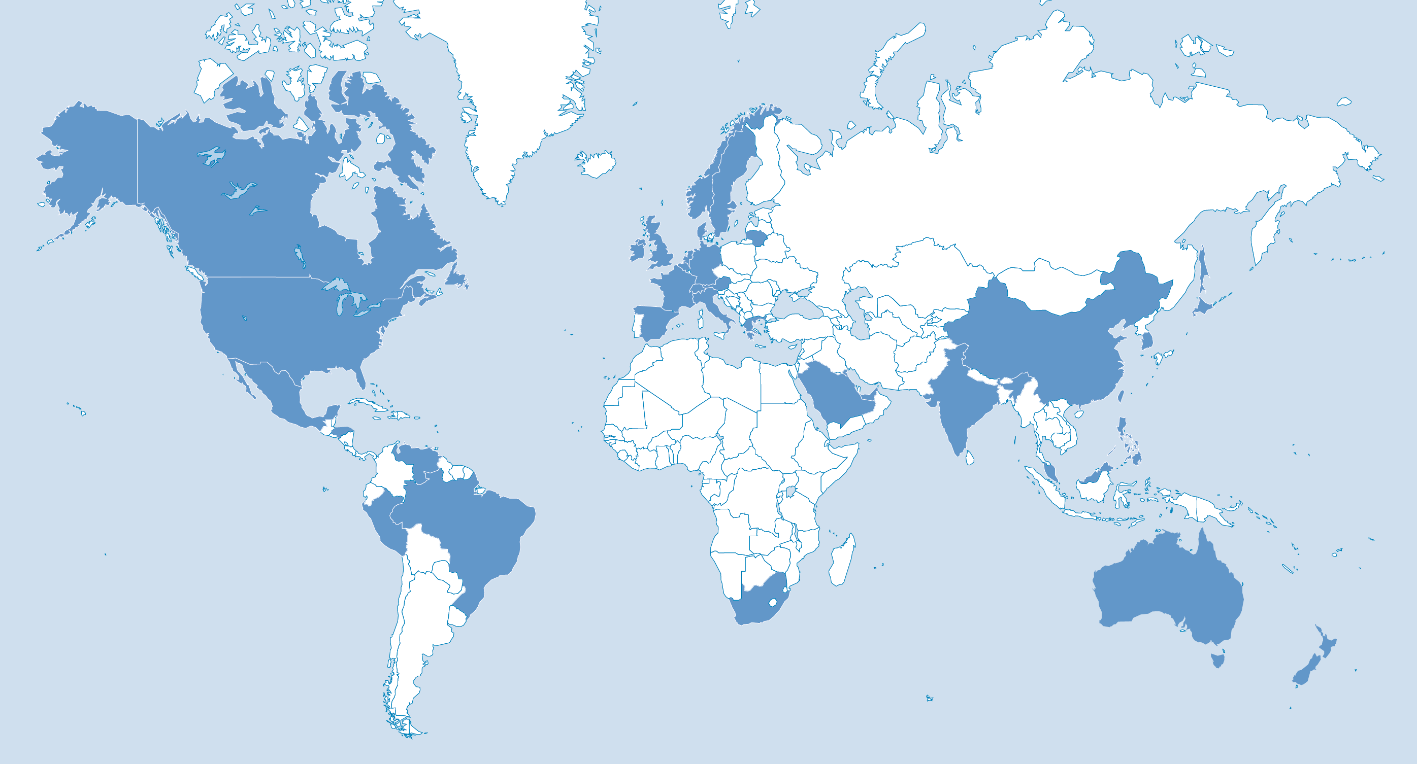
Institute of Scrap Recycling Industries, Inc.
1,700
Member companies
(400 e-recyclers)
7,000+
Recycling facilities worldwide
34
Countries
Notes:
Institute of Scrap Recycling Industries (ISRI)
ISRI is an international trade association that represents more than 1,700 member companies that process, broker and consume scrap (ranging from small, family-owned businesses to large, multi-national corporations)
Representing 7,000+ facilities worldwide - that process, broker & consume scrap metals, paper, plastics, glass, textiles, rubber, and electronics.

Slide 5







Institute of Scrap Recycling Industries, Inc.
Ferrous &
non-ferrous metals
Paper
Plastics
Glass
Rubber
Textiles
Electronics

Slide 6
Recycling Industry Snapshot

Slide 7
Industry Snapshot: $90 Billion Industry in U.S.
135,000,000
Tons processed annually
2012 U.S. Scrap Exports
47.3
$28B
160
Total exported
(million metric tons)
Value of materials
exported
Number of countries
exported to
Notes:
Recycling Globally
U.S. is the world’s largest scrap exporter.
51 million metric tons exported.
The value of exported materials is $39 billion in 158 countries.

Slide 8
Electronics Recycling in U.S.
$5B+
Industry in U.S.
4M+
Tons processed annually in the U.S.
6M
Tons available for recycling annually
Notes:
Electronics Recycling
Fastest growing segment of recycling industry, with $5 b in revenue in 2011 (only $1B in 2002)
3-4 million tons of electronic scrap processed annually
Out of approx. 6 million tons estimated to be available for collection annually
75% by volume from commercial/business sources
Future opportunity/challenge: residential/personal use electronics
ISRI has more than 400 member companies that process e-scrap for recycling

Slide 9
Electronics Recycling in U.S.
Source of all UEPs collected for recycling in the U.S.
75%
25%
Commercial & business
Residential
Huge opportunity to increase domestic recycling & job growth by focusing on the untapped reservoir of used & EOL electronics in residential sector
Notes:
Recycling Globally
U.S. is the world’s largest scrap exporter.
51 million metric tons exported.
The value of exported materials is $39 billion in 158 countries.

Slide 10
Electronics Recycling in U.S.
What Happens to UEPs Once Collected?
  › 70% recycled into specification grade commodity scrap (e.g., scrap steel, Al, Cu, etc.)
  10% resold as functioning equipment & components for direct resale
  ‹ 18% is resold as equipment & components for further repair and refurbishment
Source: IDC Survey: Inside the Electronics Industry (2011)
Notes:
Electronics Recycling
Fastest growing segment of recycling industry, with $5 b in revenue in 2011 (only $1B in 2002)
3-4 million tons of electronic scrap processed annually
Out of approx. 6 million tons estimated to be available for collection annually
75% by volume from commercial/business sources
Future opportunity/challenge: residential/personal use electronics
ISRI has more than 400 member companies that process e-scrap for recycling

Slide 11
Used & EOL Electronics
Are Used & EOL Electronics Waste?
“…products at the end of their useful life are often referred to as “e-waste,” due to the risks posed by improper handling of the potentially hazardous materials that they contain. However, this term misleadingly implies that UEPs can only be disposed of. Following the National Strategy … the Commission considers “e-waste” to be a subset of UEPs, which are also able to be reused, refurbished, or recycled for parts and commodity scrap materials.” (p. 1-3, U.S. ITC)
No, if legitimately recycled, reused, or refurbished
Yes, if disposed of
Notes:
Electronics Recycling
Fastest growing segment of recycling industry, with $5 b in revenue in 2011 (only $1B in 2002)
3-4 million tons of electronic scrap processed annually
Out of approx. 6 million tons estimated to be available for collection annually
75% by volume from commercial/business sources
Future opportunity/challenge: residential/personal use electronics
ISRI has more than 400 member companies that process e-scrap for recycling

Slide 12
UEPs & Exports

Slide 13
U.S. International Trade Commission
Of the UEPs collected in the U.S. each year,
82.8%
17.2%
Recycled, reused, or refurbished domestically
Exported
(by weight)
“Used Electronic Products: An Examination of U.S. Exports,” February 2013, U.S. International Trade Commission (U.S. ITC).
Notes:
Recycling Globally
U.S. is the world’s largest scrap exporter.
51 million metric tons exported.
The value of exported materials is $39 billion in 158 countries.

Slide 14
U.S. International Trade Commission
Of the UEPs collected in the U.S. each year,
12.1%
5.1%
Exported as
Testing & working UEPs
Working UEPs
Commodity grade scrap
Repair through warranty programs
Recycling/disposal at export destination
Final disposal
Unknown
at risk for improper recycling & disposal
the “Sliver”
Notes:
Recycling Globally
U.S. is the world’s largest scrap exporter.
51 million metric tons exported.
The value of exported materials is $39 billion in 158 countries.

Slide 15
Significant Shift in 10 years
Numbers are Important to Help Us Focus on Today’s Reality
“The Commission includes a reference to the BAN report in an effort to include all publicly available estimates of UEP exports. However, the BAN estimates were not the result of a statistical analysis. Rather, the estimates came from a nonscientific survey of industry experts’ opinions conducted over 10 years ago. As discussed in this report, there are strong reasons to believe that industry conditions have changed since that time, not least due to the efforts of the organizations that published the 2002 report. Puckett et al., “Exporting Harm,” February 25, 2002.” (U.S. ITC, p.1-11, footnote 36)
“…[I]t is becoming increasingly evident that such dumping narratives offer only a partial representation of the problem. They tend to oversimplify the global trajectory of used and end-of-life electronics. That is, they put forth a simple yet inaccurate story in which this equipment travels in a straight line from North to South. In addition, they assume that the North and South are internally homogenous.” (Transboundary Movements of Discarded Electrical and Electronic Equipment,” Djahane Salehabadi, Cornell University for StEP
(March 25, 2013))
Notes:
Electronics Recycling
Fastest growing segment of recycling industry, with $5 b in revenue in 2011 (only $1B in 2002)
3-4 million tons of electronic scrap processed annually
Out of approx. 6 million tons estimated to be available for collection annually
75% by volume from commercial/business sources
Future opportunity/challenge: residential/personal use electronics
ISRI has more than 400 member companies that process e-scrap for recycling

Slide 16
Focus of Numerous Recent Looks
U.S. ITC: Most comprehensive study to date of exports
Proven methodology
Nationwide survey of 5,200 entities compelled by federal law to respond
Augmented by census and other data, including site visits
White House/OMB/USTR approval of methodology
United Nations University StEP Initiative
  2013 Green Paper Series on Exports of UEPs
CNN International
Notes:
Electronics Recycling
Fastest growing segment of recycling industry, with $5 b in revenue in 2011 (only $1B in 2002)
3-4 million tons of electronic scrap processed annually
Out of approx. 6 million tons estimated to be available for collection annually
75% by volume from commercial/business sources
Future opportunity/challenge: residential/personal use electronics
ISRI has more than 400 member companies that process e-scrap for recycling

Slide 17
Significant Shift in 10 years
Positive Developments in U.S. and Global E-Recycling
(as reported by the U.S. ITC, UNU, StEP, and others)
Capacity has increased in the U.S. and elsewhere
New recycling technologies improving efficiency and recovery
Increased foreign smelting capacity to process non-working and used electronics. Of note is that some of this capacity is in developing countries
New regulations and increased enforcement
3rd party certification
Of concern: “an increasing share of material flowing into the informal processing sector in developing countries appears to be locally or regionally sourced, with less originating in the U.S.”
Notes:
Electronics Recycling
Fastest growing segment of recycling industry, with $5 b in revenue in 2011 (only $1B in 2002)
3-4 million tons of electronic scrap processed annually
Out of approx. 6 million tons estimated to be available for collection annually
75% by volume from commercial/business sources
Future opportunity/challenge: residential/personal use electronics
ISRI has more than 400 member companies that process e-scrap for recycling

Slide 18
U.S. International Trade Commission
12.1%:
“by value, most exports were products that were refurbished & resold as working computers, cell phones, and other used products. Measured by weight, most exports were scrap materials, which come from UEPs that are disassembled or recycled in the United States. Commodity metals, plastics and glass are exported to smelting facilities to recover gold and other precious metals. Only a small share of U.S. exports of UEPs was sent overseas for disposal.” U.S. ITC Report, pp.xi.
Notes:
Recycling Globally
U.S. is the world’s largest scrap exporter.
51 million metric tons exported.
The value of exported materials is $39 billion in 158 countries.

Slide 19
U.S. International Trade Commission
The 5.1%
Need to focus on that which is at risk for improper recycling & disposal through a combination of –
Export restrictions
Greater enforcement of existing rules
Shutting down informal sector
Building up responsible recycling globally for us all
Engagement to turn the tide on irresponsible recycling
  Recommendation of Obama Administration
  Knowledge exchange on best practices
Notes:
Recycling Globally
U.S. is the world’s largest scrap exporter.
51 million metric tons exported.
The value of exported materials is $39 billion in 158 countries.

Slide 20

Controlling the Sliver
Responsible recycling globally should include –
Ban on export of UEPs for landfill & incineration
Restrictions on export of UEPs with FMs for repair, refurbishment, and recycling
No restrictions on export of commodity-grade scrap & fully tested & working UEPs for reuse
Strict enforcement/prosecution in accordance with domestic & international laws
Notes:
Recycling Certification Trends
U.S. scrap industry committed to not just delivering plentiful volumes of scrap, but delivering high quality scrap for both domestic and international customers in an environmentally responsible manner
On a basic level, achieving this through use of globally accepted specification guidelines

Slide 21
ISRI Policy: Responsible E-Recycling
Restrictions on export of UEPs with FMs for repair, refurbishment, and recycling should include --
No geographic distinction (OECD vs non-OECD)
1-time notification + register with EPA
Strict due diligence
Notes:
Recycling Certification Trends
U.S. scrap industry committed to not just delivering plentiful volumes of scrap, but delivering high quality scrap for both domestic and international customers in an environmentally responsible manner
On a basic level, achieving this through use of globally accepted specification guidelines

Slide 22
ISRI Policy: Responsible E-Recycling
Past Efforts to Legislate
Laudable effort but doesn’t address underlying problem and imposes arbitrary restrictions
Ignores conclusions of Obama Administration National Strategy for Electronics Stewardship and others (e.g., see March 2013 StEP Green paper concluding that policies that focus solely on closing the loopholes through which e-waste flows “appear doomed to limited effectiveness, at best.”)
In violation of U.S. international trade obligations (CRS)
Notes:
Recycling Certification Trends
U.S. scrap industry committed to not just delivering plentiful volumes of scrap, but delivering high quality scrap for both domestic and international customers in an environmentally responsible manner
On a basic level, achieving this through use of globally accepted specification guidelines

Slide 23
Role of Certification

Slide 24

Integral Part of Responsible Recycling
Independent certifications
  Competitive advantage
  Customer requirement
  Operational improvement
Notes:
Independent, third-party, certification systems are becoming the industry norm within the scrap and electronics recycling industries to ensure responsible recycling.
Top reasons for pursuing certification:
Competitive advantage
Customer requirement
Operational improvement

Slide 25
Integral Part of Responsible Recycling
Multiple Certification Routes to Responsible Recycling
  ISO 9000, ISO 14001, OHSAS 18001
  R2TM and R2:2013TM
  RIOSTM
  E-Stewards
Notes:
Independent, third-party, certification systems are becoming the industry norm within the scrap and electronics recycling industries to ensure responsible recycling.
Top reasons for pursuing certification:
Competitive advantage
Customer requirement
Operational improvement

Slide 26

Recycling Industry Operating Standard™ (RIOS ™)
ANSI-ASQ National Accreditation Board (ANAB) supported
QEH&S management system
Third-party certification
Voluntary
Gaining broader acceptance
AQSIQ requirement
“Top Standard” by Green Grid/StEP Initiative
ISO 9001
ISO 14001
OHSAS 18001
Notes:
RIOS
RIOS stands for the Recycling Industry Operating Standard™
It is a voluntary, comprehensive environmental, health & safety, and quality management system
RIOS was developed based primarily on the requirements of ISO 9001, ISO 14001, and OHSAS 18001
RIOS is a third-party certification
Accredited certification program supported by the ANSI-ASQ National Accreditation Board (ANAB)

Slide 27


R2/RIOS™
+
86
RIOS™ and R2/RIOS™ facilities
110+
Facilities in certification process
Notes:
R2/RIOS
R2/RIOS is a combination of the Responsible Recycling Practices (“R2”), developed by U.S. EPA and RIOS
Promotes sustainable electronics recycling
There are currently ## facilities R2/RIOS™ certified
And ## facilities engaged in certification process

Slide 28
R2:2013
Effective July 1, 2013
Stringent, accountable standard
  EHSMS requirement (ISO14001and OHSAS18001 or RIOSTM)
  Explicit compliance with laws of all exporting, importing, and in-transit countries
  Extensive downstream due diligence through each downstream vendor until it is sold for reuse or as a commodity
  Data security and destruction
Notes:
R2
R2 is written, openly, not too prescriptive, allows varying scopes in the recycling stream. E.g., provision 3 accounts for different legal obligations, for example, R2 covers the BAN amendment when it is legally required. No geographic distinctions, the provisions equally anywhere in the world
R2 requires a recycler to:
Establish a reuse and recovery hierarchy of responsible materials management
Comply with all legal requirements, including imports and exports
Manage Focus Materials (FMs) on site and through selected downstream processors
Maintain security measures in all parts of the facility
Possess adequate insurance and facility closure plan

Slide 29
R2:2013
Multi-Stakeholder Review & Approval
  Best Buy, Dell, Microsoft, etc.
  Overseen by independent body: R2Solutions.org
400 E-Recyclers Currently Certified to R2
  18-month Transition Period
Global in its reach
  facilities certified in Australia, China, Costa Rica, Canada, England, Germany, Hong Kong, India, Ireland, Malaysia, Mexico, New Zealand, Singapore, and South Africa
Notes:
R2/RIOS™ can help address the global issues of e-recycling.
The certification program helps to discourage illegal and sham recycling through the promotion of sustainable recycling and sharing knowledge of recycling done right.
There are other strong benefits to R2/RIOS. Positive intervention and knowledge-sharing can also boost economic development and job creation
If we turn our back to the informal sector in the developing world by banning the export of valuable commodities, it does not mean that the problem of the informal sector will disappear. Instead, we need to encourage environmentally responsible and safe recycling practices globally.
Our goal must be to have electronics recycling done right anywhere and everywhere in the world.
29

Slide 30
Final Thoughts …
“By …2025 the developing world will generate double the developed world’s used and EOL computers.”
Journal of Environmental Science and Technology, 2010
Notes:
Instead of banning trade the US and others should teach developmental countries how to improve health and safety conditions and encourage environmentally responsible practices.

Slide 31
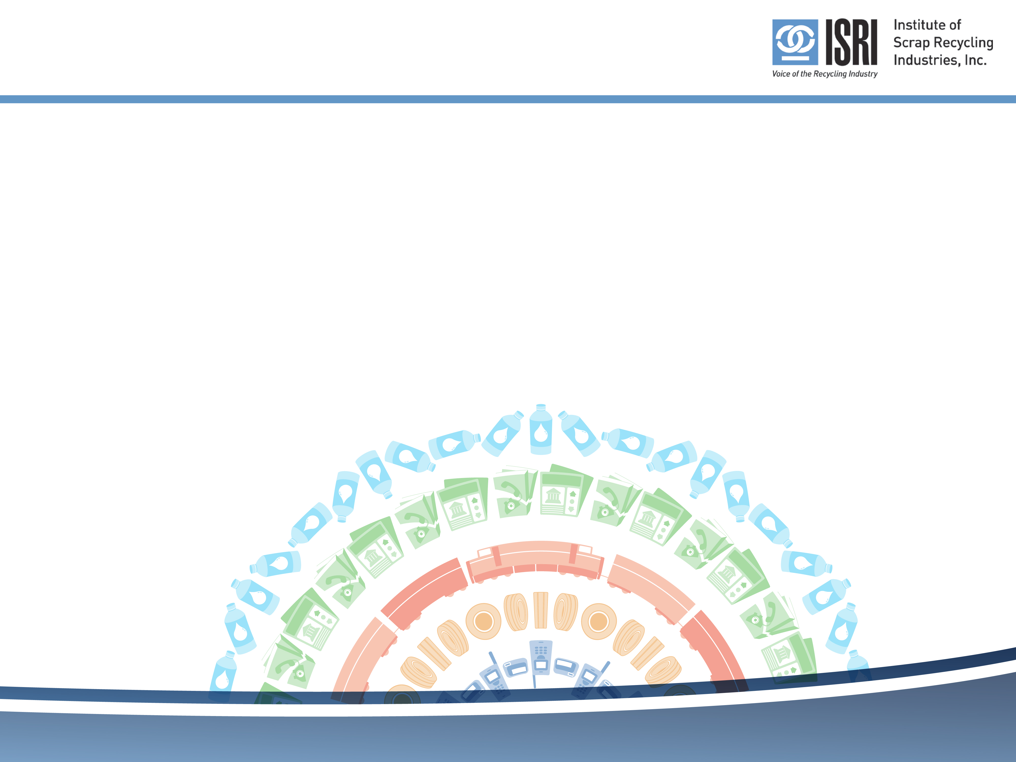
Thank You
Robin K. Wiener
President
Institute of Scrap Recycling Industries, Inc.
RobinWiener@ISRI.org
202-662-8512
www.isri.org
www.isri.org/certifyme

